Slide 1
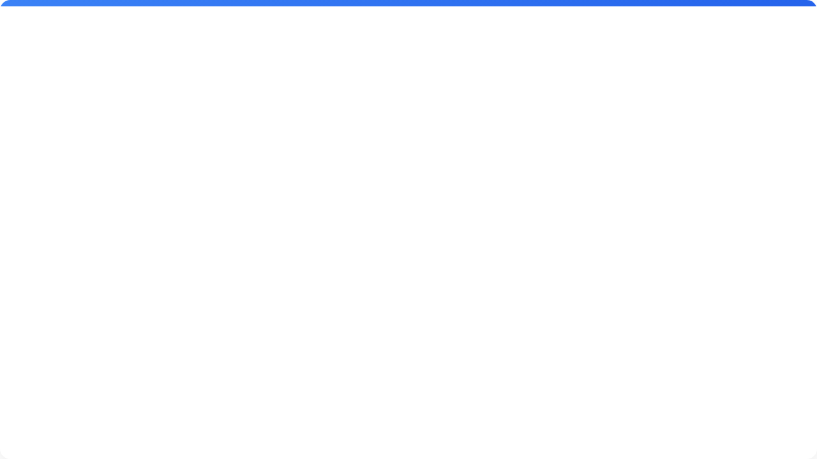







How It Works: 3 Simple Steps
1. The Request
2. The Check
3. The Invite
You fill out a simple form online to ask for a Council Member's time.
The system automatically checks all 7 calendars instantly to see who is free.
If they are available, the system sends a meeting invite to everyone right away.

Slide 2




See It In Action
The Power App
The Automation
The public form where requests are submitted.
The logic that checks calendars and sends emails.
Open Form
View Flow

